Slide 1

Campus Fiction
Sonal Jha, PhD
Department of Humanities and Social Sciences
IIT Roorkee

Slide 2

Academia as “The Ivory Tower”
Term used to signify the disconnect between academia and everyday life
Also signifies privilege and separation

Slide 3

What is Campus Fiction?
•
A Closed World: The university campus acts as a microcosm of society, isolated from the "real world," allowing for intense scrutiny of social dynamics.
•
Satire & Critique: Often satirizes intellectual pretensions, academic politics, and the disconnect between theory and reality.
•
The "Coming of Age": Frequently explores the Bildungsroman arc for students, or the mid-life crises of professors.
•
Key Tensions: The Town vs. Gown conflict, tradition vs. modernity, and the pursuit of knowledge vs. institutional bureaucracy.

Slide 4





Core Themes of the Genre
Intellectual Rivalry
Social Mobility
Comedy or Tragedy
Petty squabbles over tenure, publications, and office space often mask deeper existential anxieties among faculty members.
The campus as a gateway to the middle class, where characters navigate class barriers, elitism, and the promise of meritocracy.
The genre swings between hilarious misunderstandings (e.g., Lucky Jim) and dark secrets (e.g., The Secret History).

Slide 5
Global Landmarks
1954
1965
1992
2000
Lucky Jim Kingsley Amis
Stoner John Williams
The Secret History Donna Tartt
The Human Stain Philip Roth
Seminal satire of provincial academic life.
A quiet, tragic portrait of a scholar.
Dark academia and corruption.
Identity politics and culture wars.

Slide 6

The Indian Context
From University Politics to the IIT Dream

Slide 7
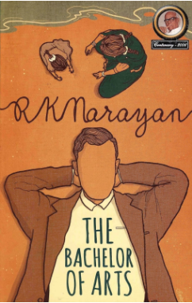
The University Novel
Before the engineering boom, Indian campus fiction focused on the liberal arts experience, grappling with colonial identity, caste politics, and student activism.
•
The Bachelor of Arts (1937): R.K. Narayan’s classic tale of Chandran, whose post-graduation wanderings explore the tension between Western education and traditional Indian life.
•
No Onions Nor Garlic (2006): Srividya Natarajan's sharp satire of a Chennai university English department, exposing deep-seated caste prejudice in academia.
•
Up Campus, Down Campus (2009): Captures the politically charged atmosphere of JNU, where ideology and romance intertwine.

Slide 8


The Rise of the "IIT Novel"
Post-liberalization India saw a shift from the reflective, colonial-era narratives to the high-pressure world of technical education.
The Turning Point: Chetan Bhagat's Five Point Someone (2004) democratized the genre, focusing on the average student's struggle within an elite system. This spawned a sub-genre dealing with entrance exams, hostel life, and the "engineering dream."

Slide 9
Distinctive Features of IIT Campus Fiction
•
The Pressure Cooker: Unlike the leisurely pace of Western liberal arts novels, IIT fiction often centers on the grueling pressure of competitive exams.
•
Parental Aspiration: The student carries the weight of middle-class family expectations, making failure a catastrophic social event.
•
Language & Vernacular: The use of "Hinglish" and campus slang to capture the authentic voice of the youth.
•
Ragging & Hierarchy: Exploring the sometimes brutal power dynamics between seniors and juniors in hostel life.

Slide 10
Amitabha Bagchi’s Above Average (2007)

Slide 11
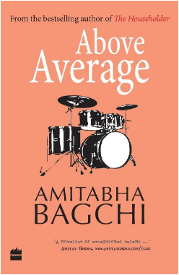
Introduction to the Text
•
Author: Amitabha Bagchi (IIT Delhi alumnus).
•
Publication: 2007, HarperCollins India.
•
Setting: IIT Delhi
•
Premise: The story follows Arindam Chatterjee, a student who feels out of place in the hyper-competitive environment of IIT.
•
Significance: Unlike Bhagat’s ‘Bollywood-ised’ narrative, Bagchi's work is noted for its literary quality, introspective tone, and nuanced character study.

Slide 12
The "Average" Hero
Arindam represents the "silent majority" in elite institutions—those who are intelligent but not geniuses, who struggle to find their identity beyond their Grade Point Average.
While his peers chase high-paying corporate jobs and US grad school admissions, Arindam finds solace in playing the bass guitar for his rock band. The novel chronicles his oscillation between the demands of the "system" and his artistic inclinations.

Slide 13




Key Themes in Above Average
Mediocrity vs. Excellence
The novel questions the definition of "success." Is being "above average" enough in a world that demands perfection?
Male Friendship
It sensitively portrays the bonds formed in hostels—relationships defined by shared anxieties, banter, and unspoken support.
Professional Aspiration vs. Alternative Paths
Through the subplot of the band, Bagchi explores the possibility of pursuing passion over pragmatism in middle-class India.

